Slide 13
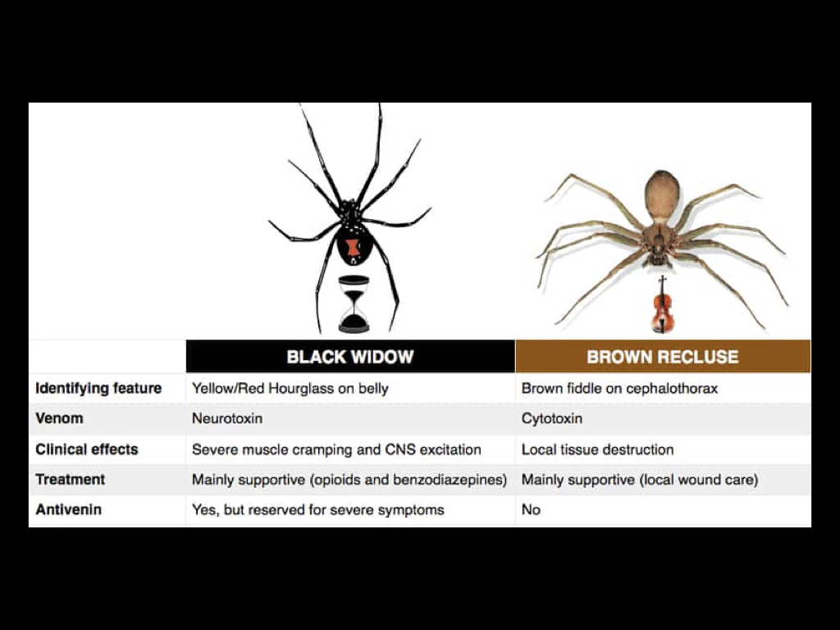

Slide 18
*important* if patient develops increased compartment pressures the treatment is antivenom NOT fasciotomy.

Slide 21
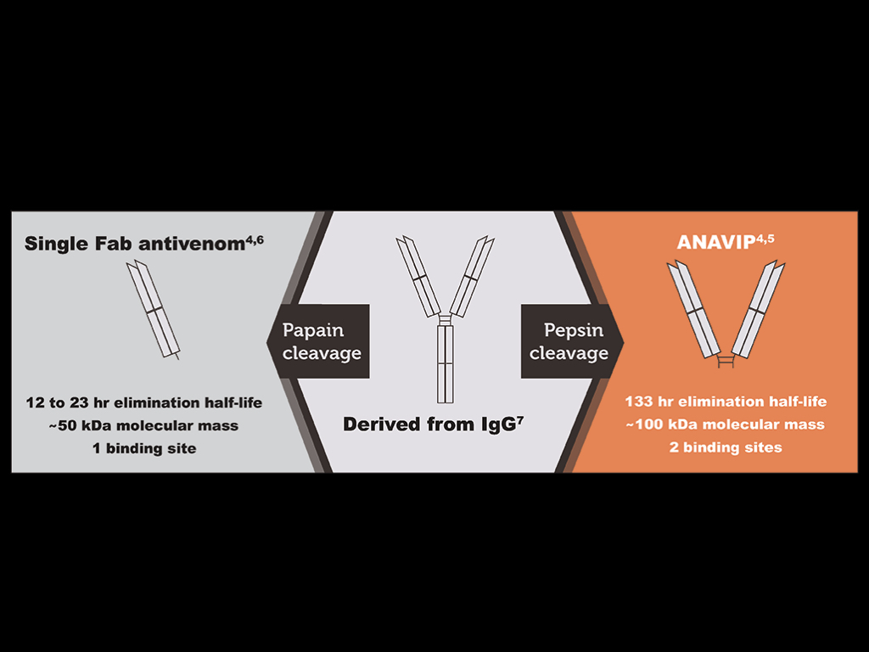

Slide 26
