Slide 12
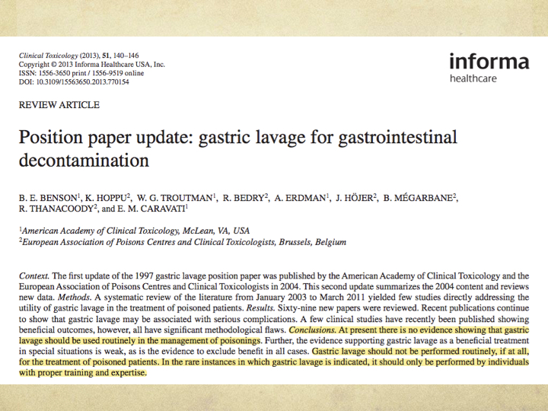

Slide 17
*important* AC aspiration can result in Bronchiolitis obliterans organizing pneumonia (BOOP) and ARDS; not just your run of the mill aspiration pneumonia.

